Slide 1

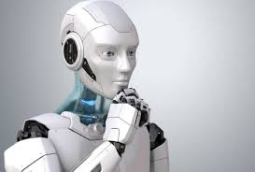
AI Based Virtual Assistant
Vishwakarma Institute of Technology, Pune
Department of SY Common B-Tech
AY 2021-22
Presentation topic:
Name : Aniruddha Manohar Joshi
Roll No: 51
PRN : 12011234
Subject: SDP
Guide: Prof. Deepali Deshpande

Slide 2
Contents
Problem Statement
Introduction
Objectives
Literature Survey
Tools & Technology
Action plan
Methodology
Limitations and Future Scope
Conclusion

Slide 3
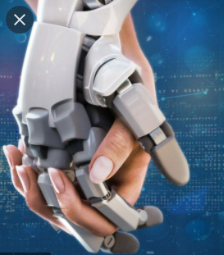
Problem Statement
To develop and design an interactive and complete virtual assistant for windows and simplify the tasks for the user.
Cortona, Siri, Alexa, Google assistant which are designed for the windows or android or mac users.
But to our surprise, there is no such complete assistant for windows platform.

Slide 4

Objectives
To develop and design an interactive and complete virtual assistant for windows.
To simplify the tasks for the user.
To help the user with the variety of commands

Slide 5
Introduction
Today, the AI is booming the market and thus the interest of the whole world by creating the natural human – machine – Interaction
The applications(rest assistants) mostly work on android
But, The proposed system performs the tasks on windows, mac, linux operating systems.
It takes the input from the user through audio (can be text) and gives the appropriate output in various forms by performing the commands.

Slide 6
Literature Survey
Sr. No. | Name of the paper | Authors | Learning techniques | Summary
1 | Jarvis - A Virtual Assistant based on Artificial Intelligence(2020) | Dr.M. Sharada Varalakshmi, Dr.P. Lavanya,Sai Prakash Reddy | Speech - Text Representation , Phonetics, Python, Mel Frequency Cepstral Coefficient | Basics of the project are grounded in the frequency and its analysis. This paper has examined voice acknowledgment calculations which are significant in improving the voice acknowledgment execution .(which is significantly different from Alex assistant.) The procedure had the option to verify the specific speaker dependent on the individual data that was remembered for the voice signal.
2 | AI Based Voice Assistant Using Python(2019) | Deepak Shende, Ria Umahiya, Monika Raghorte, Aishwarya Bhisikar, Anup Bhange | Python, API calls, Context Extraction , System call | They built an assistant using AI and IOT. As a backend they have used the python libraries and tools. It not only works on human commands but also gives responses to the user on the basis of a query being asked or the words spoken by the user such as opening tasks and operations.

Slide 7
Sr. No. | Name of the paper | Authors | Learning techniques | Summary
3 | Smart Python Coding through Voice Recognition(2019) | M. A. Jawale, A. B. Pawar, D. N. Kyatanavar | Python, PHP, mysql, | They have addressed the problem of student while the users are continuously typing for the computer program. According to them, machine will take the input through voice and will compare it with the stored keyboard and thus develop the program. With the languages mentioned , they are going to do tedious task simpler.
4 | Opportunities for Automating Email Processing: A Need-Finding Study(2019) | Soya Park, Amy X. Zhang, Luke S. Murray, David R. Karger | Python, Web Development techniques, datasets, APIs | They have addressed the problem of sending the repetitive as well as all the categories regarding email addressing. They gathered information about email processing and users in a datasheet. The paper tells that , they have developed the YouPS API interface where email addressing becomes non tedious task.

Slide 8

5 | A Review Paper on Smart Personal Assistant(2016) | Yogendra Kumar Sharma, Neeraj Sharma. | DBPedia, WordNet, and Yago , Java, Prolog, C++, SUSE Linux Enterprise server 11 | According to the paper, an Assistant provides natural language interaction to the user’s device, with the coordination of a range of specialist job assistants. The architecture used, is a BDI architecture for coordination and dialogue actions, and communication between agents. The programming languages used to develop the program are Java, Prolog, and C++ and it runs on the SUSE Linux Enterprise server 11 operating system using Apache's OOP architecture that allows distributed computing.

Slide 9
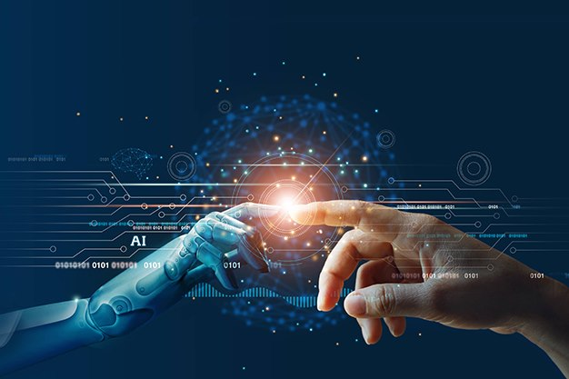
Tools & Technology
Visual Studio Code
AI and Computer Vision
Python OOP
Objects and Functions
Modules like os , wikipedia, pyttsx3, speech_recognition, open cv, webbrowser, etc..

Slide 10
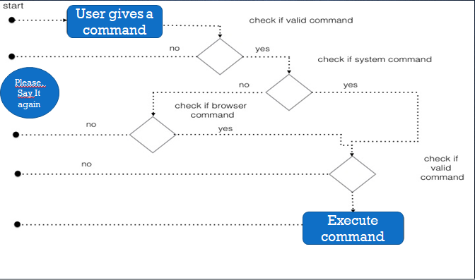
Action plan
.

Slide 11

Methodology
To explore the tasks that are to be performed.
Study the modules and packages required to fulfill the task
Using appropriate OOP language and interpreter.
Defining the functions for appropriate commands and training the system with proper logic to understand commands.
Initializing loops and handling the dataset.
Exploring maximum possible commands.

Slide 12
Limitations:
As there is no GUI made. So it should be operated on console
The system should have Internet connectivity.
Still the model can be modified by exploring the commands.
Automation especially in today’s world is a never ending thing.
Model can also be updated by adding google maps as well as location access to the user. Predictions and some data analysis can also be loaded in the system so that users will be able to predict future results.
Future Scope:

Slide 13
Conclusion
Basically, the system takes the input from the user through voice commands and responds appropriately to the user.
The task is never going to be completed. It can be updated from time to time.
It has its own security and hence security issues are not there so far. So now the model performs various tasks based on the commands. Whether the tasks are online or offline, doesn’t matter. The system is efficient to do so.
Notes:
Limitations and future scopes are in my mind to work accordingly

Slide 14
Thank You!!

